Slide 1
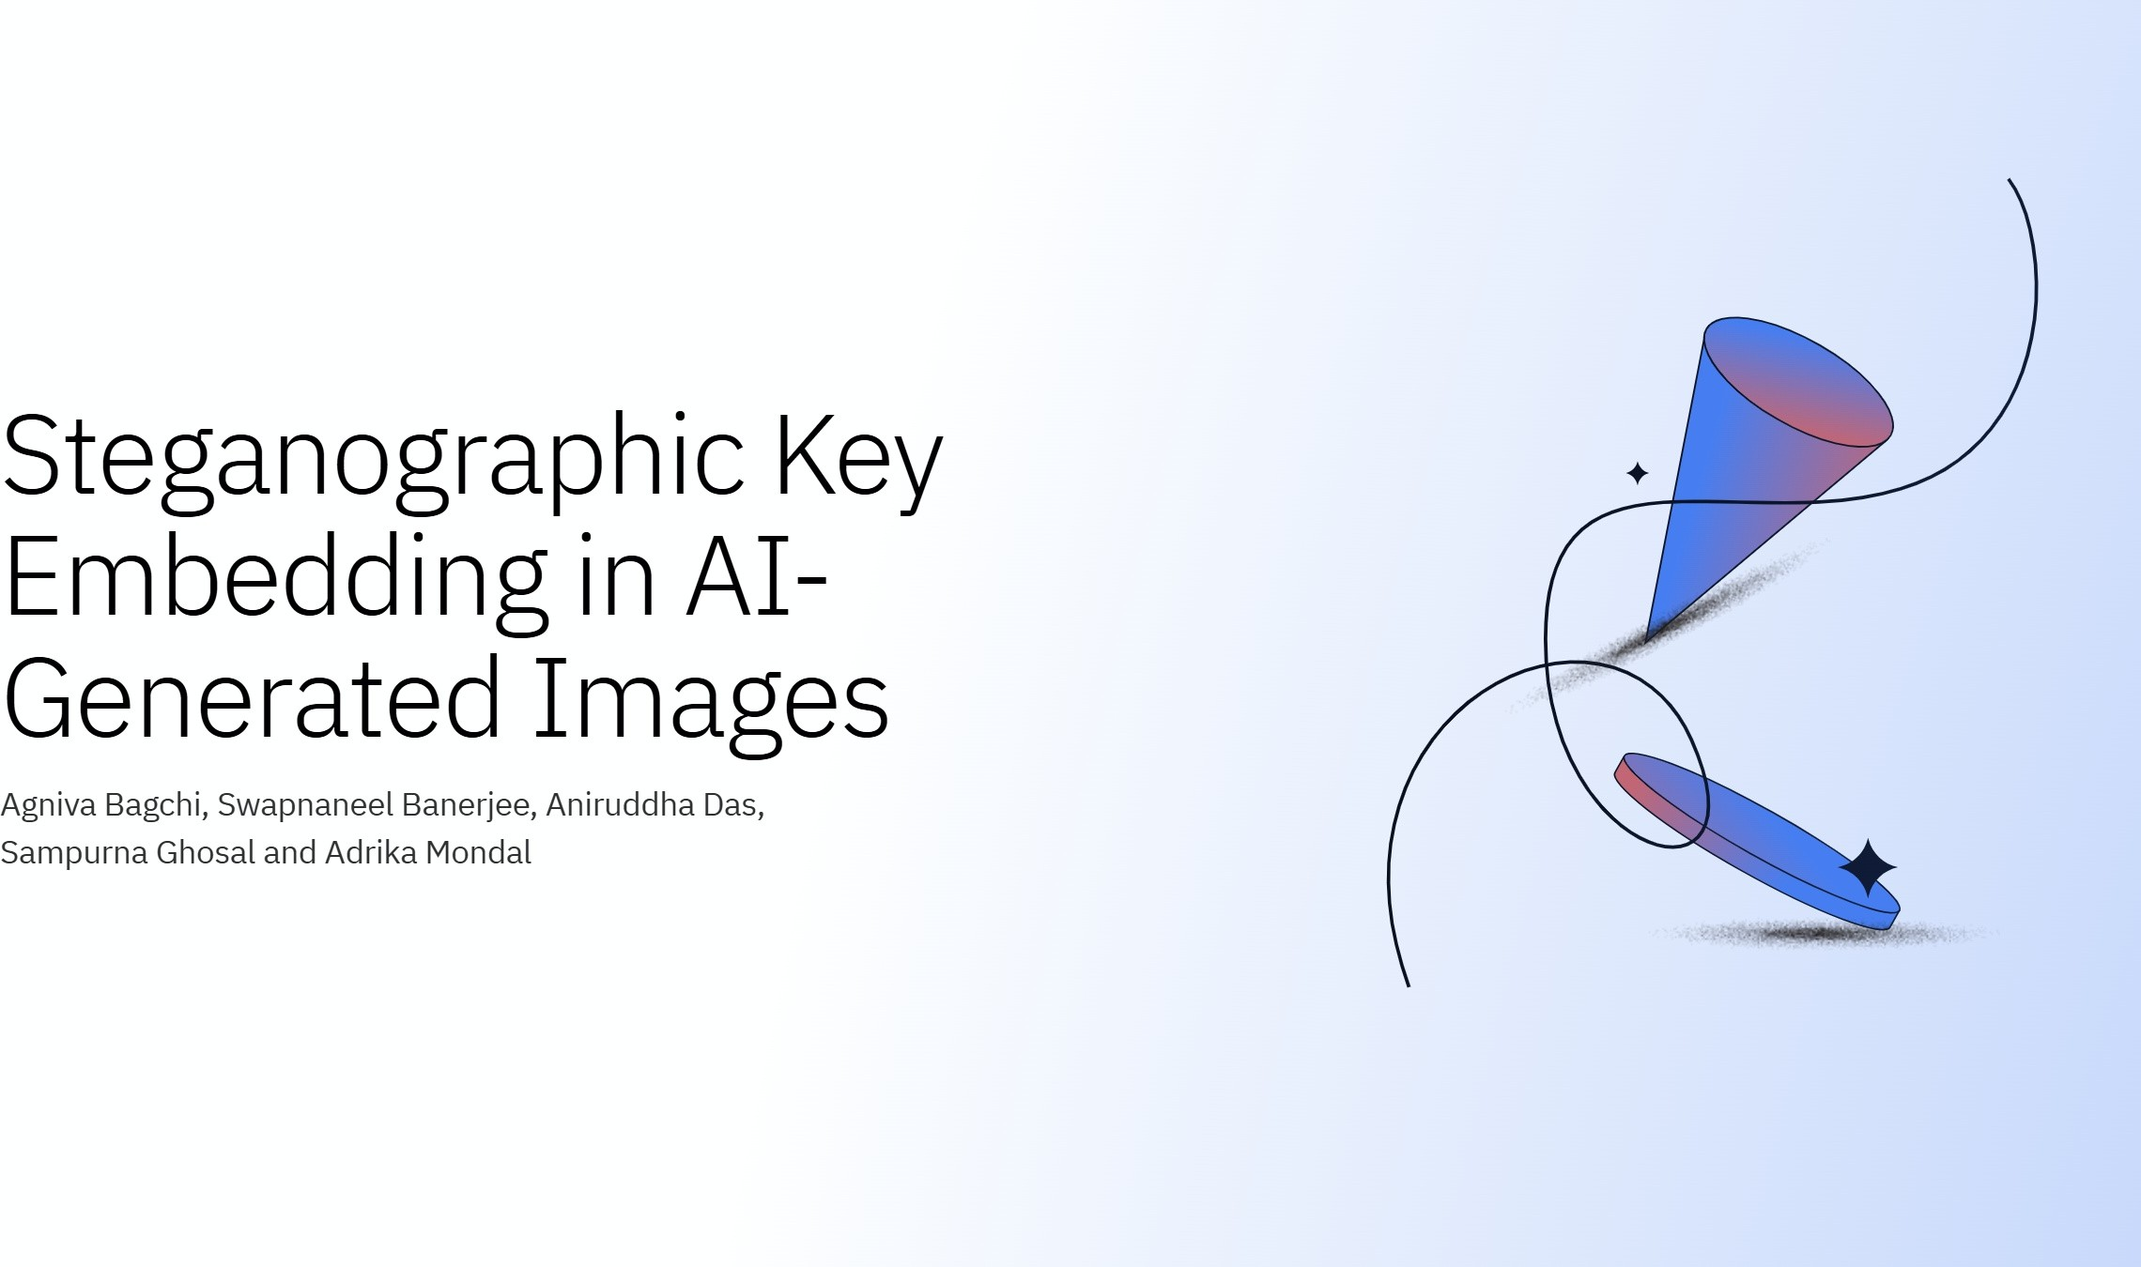
University of Engineering and Management, Kolkata

Slide 2


Slide 3
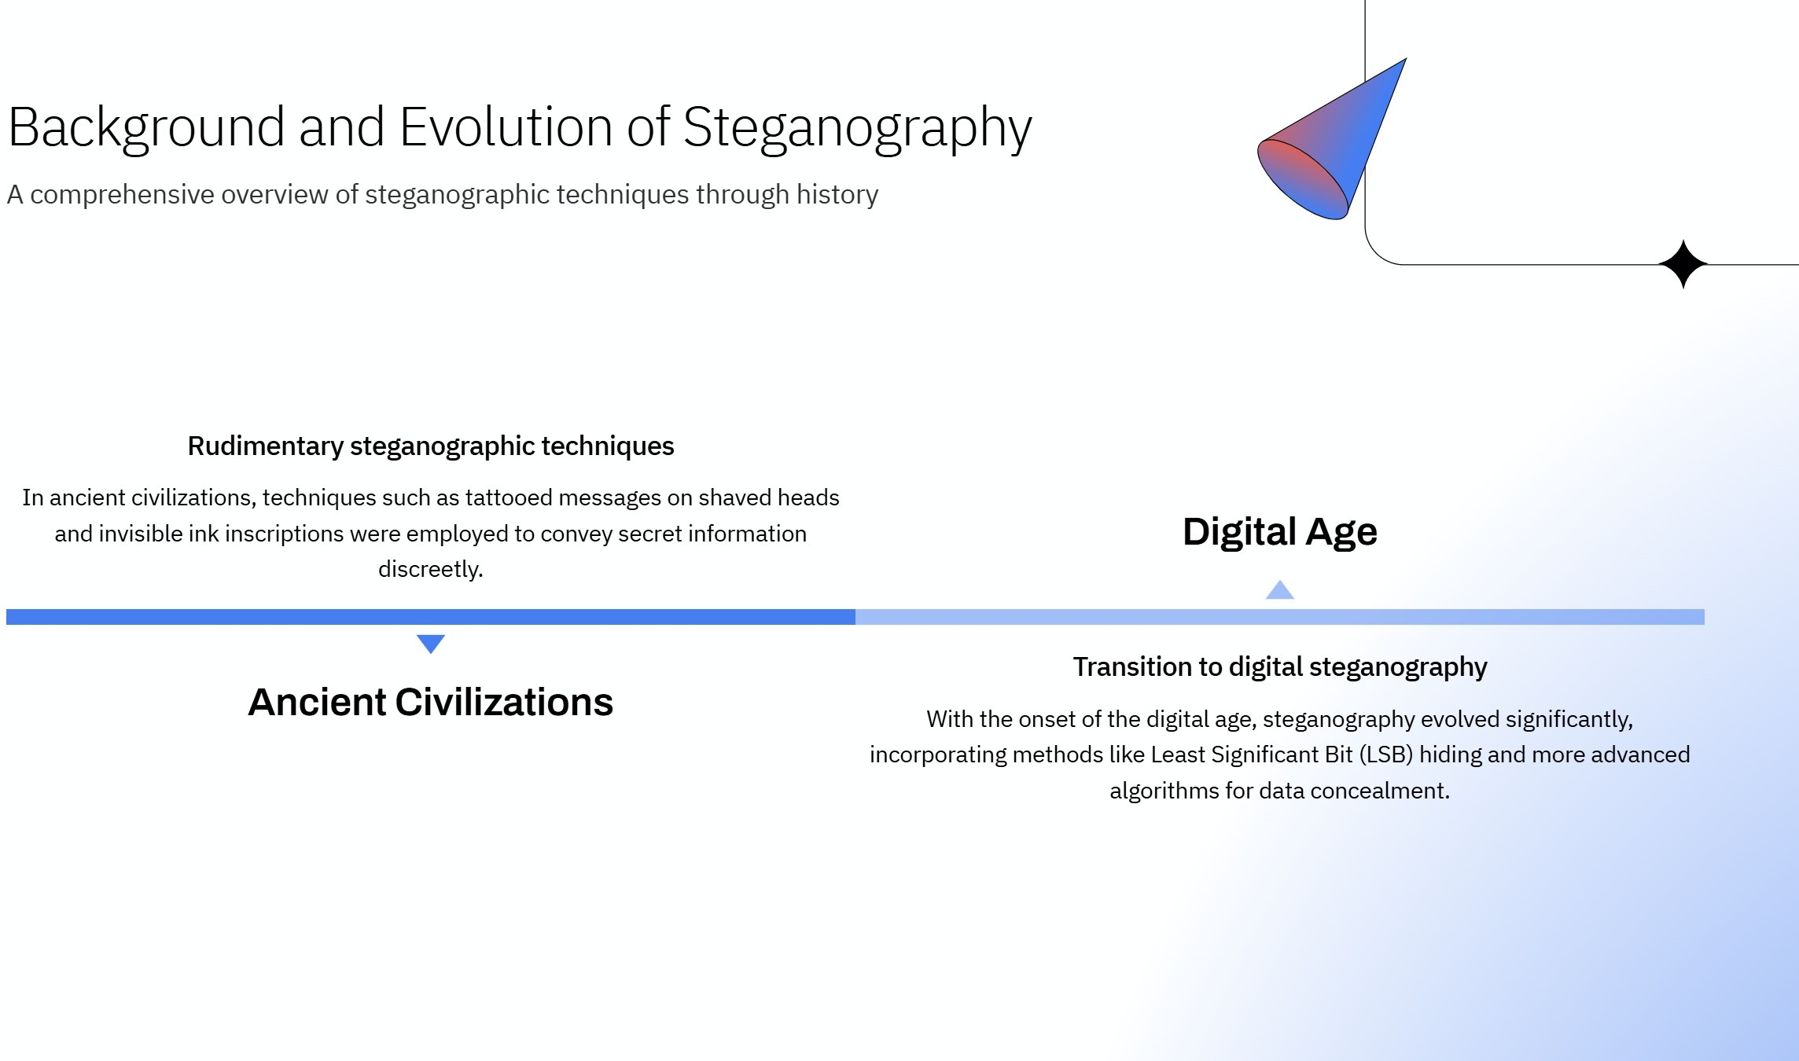

Slide 4
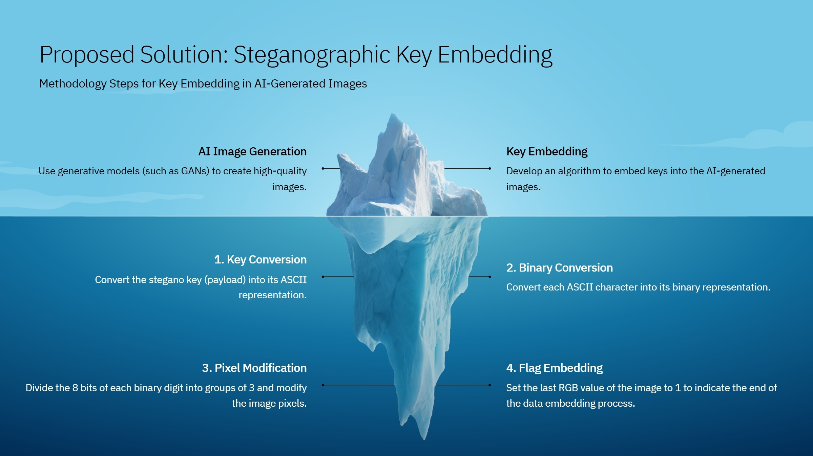

Slide 5
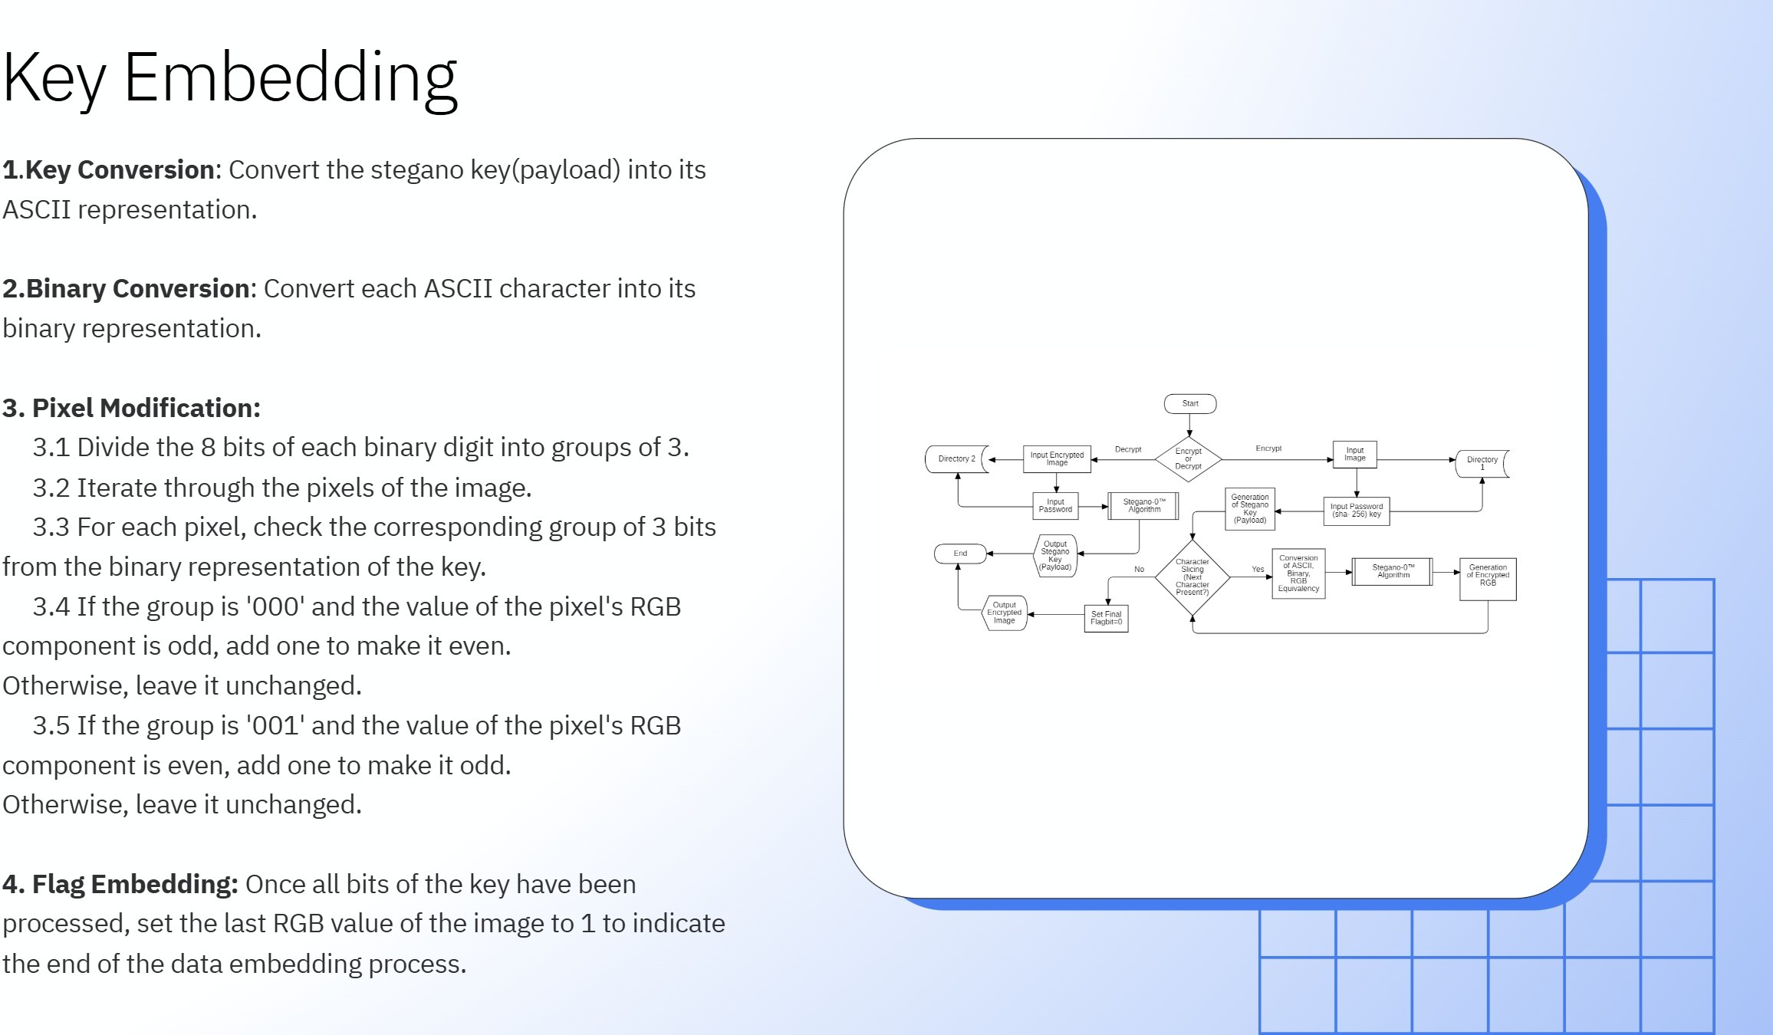

Slide 6
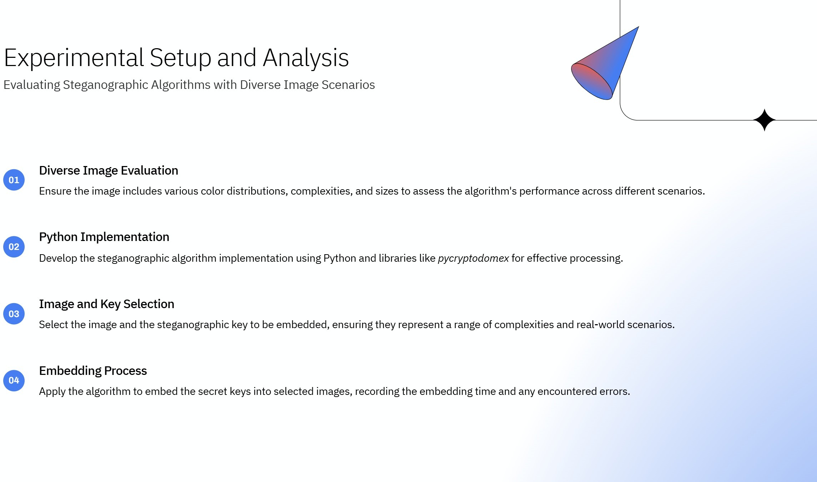

Slide 7
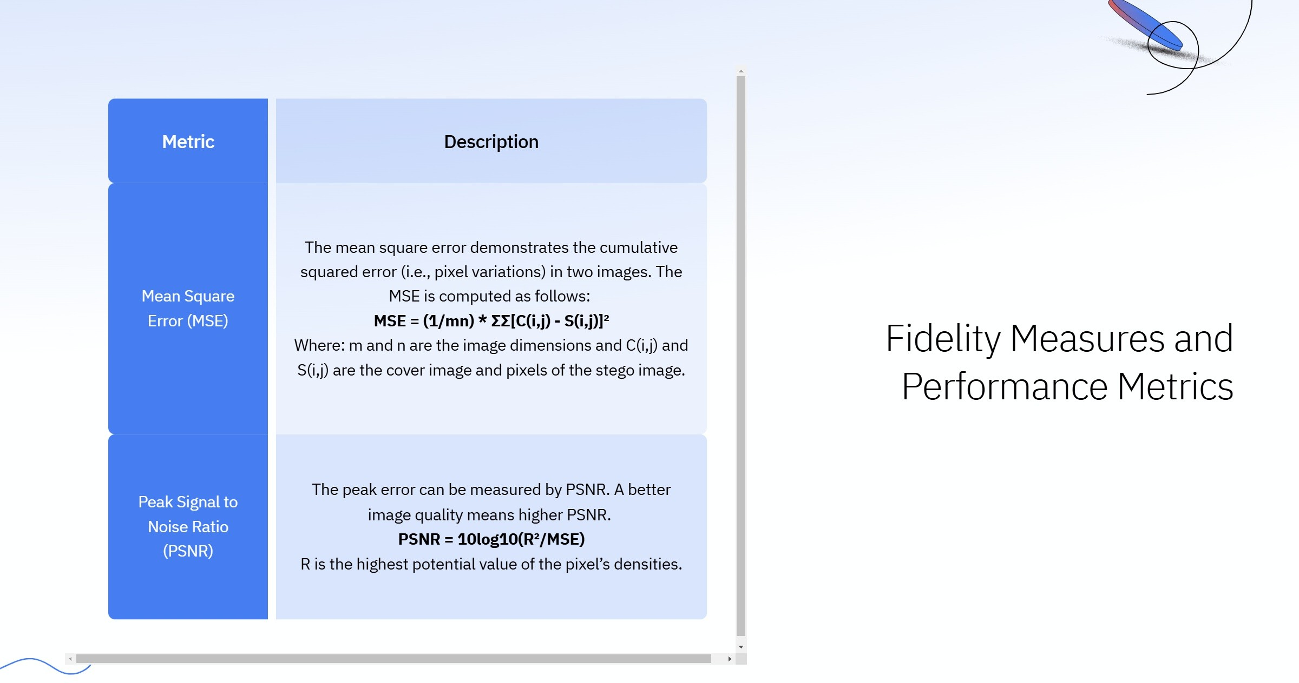

Slide 8
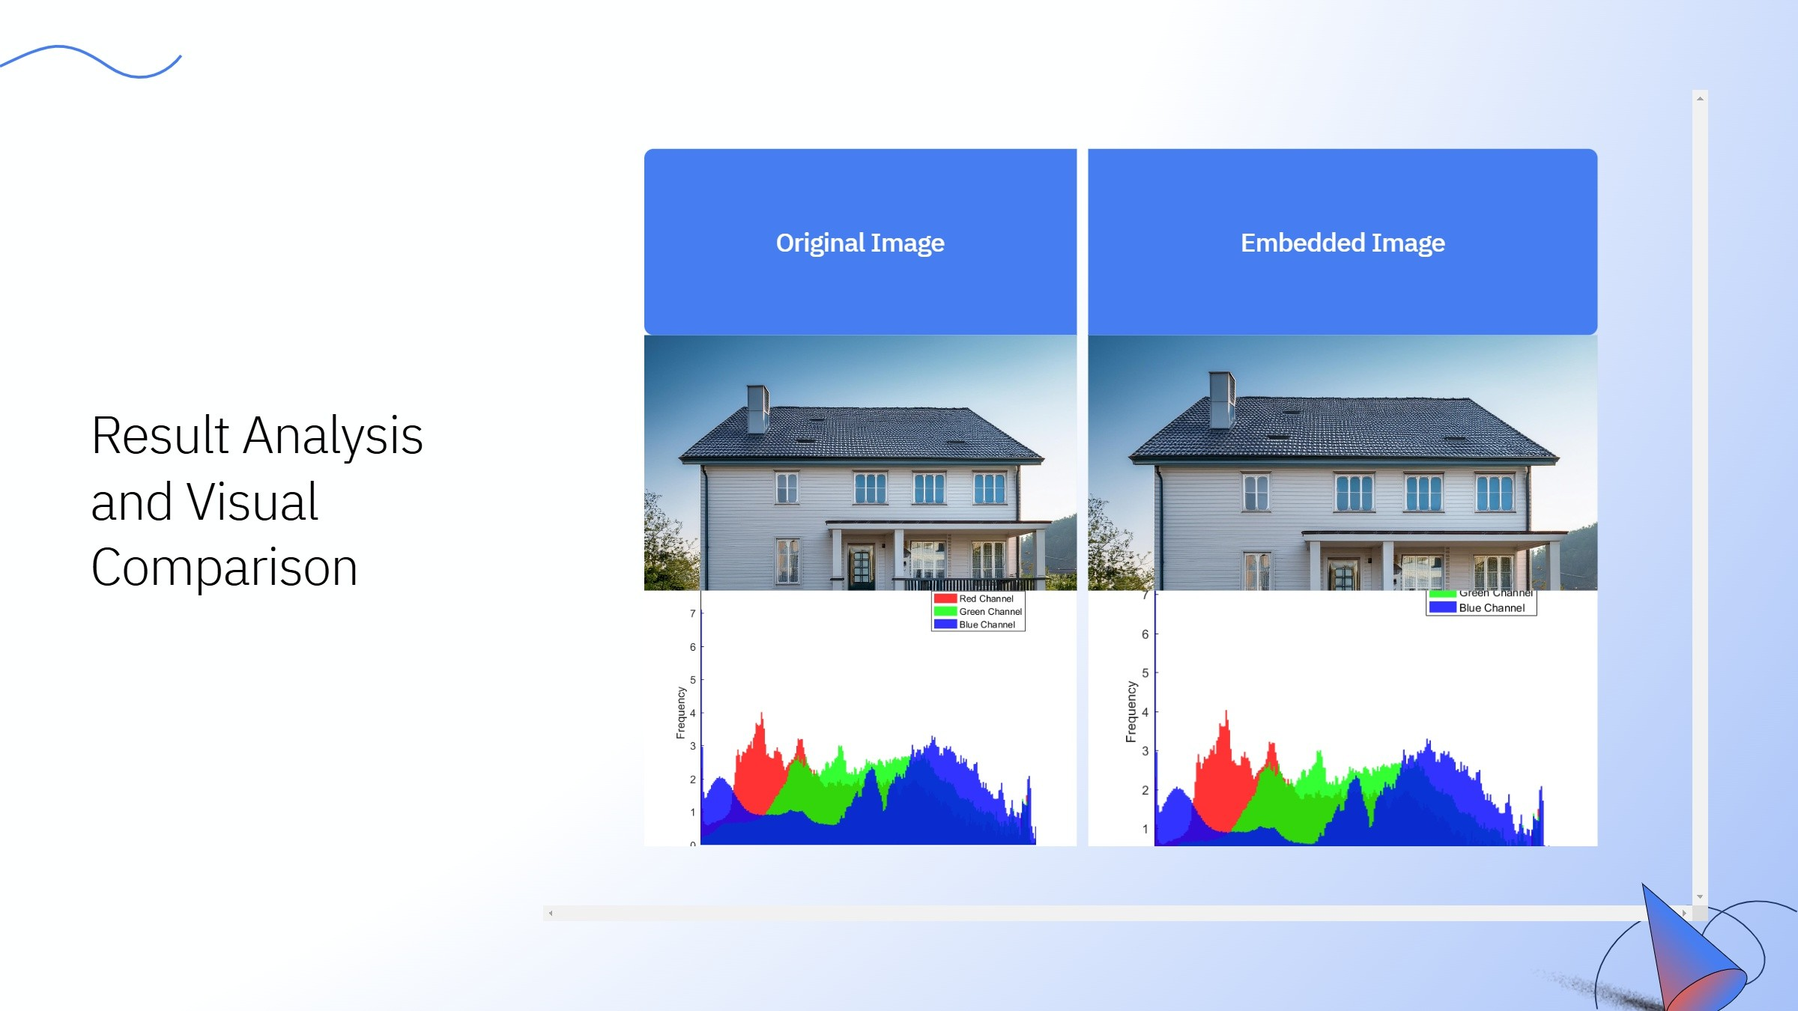
Original Image
Embedded Image
Original Histogram
Embedded Histogram

Slide 9

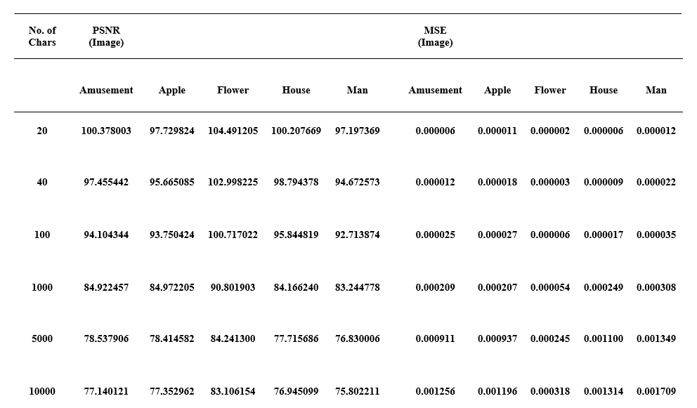
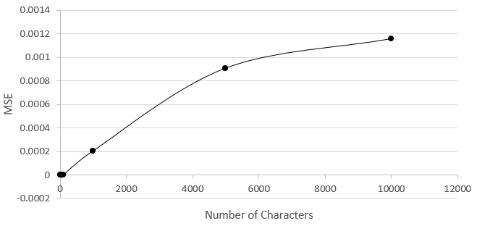
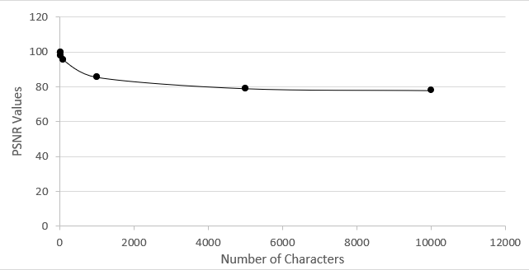
MSE Value Versus Number of Characters Graph
PSNR and MSE Values for Different Characters
PSNR Value Versus Number of Characters Graph

Slide 10


Slide 11
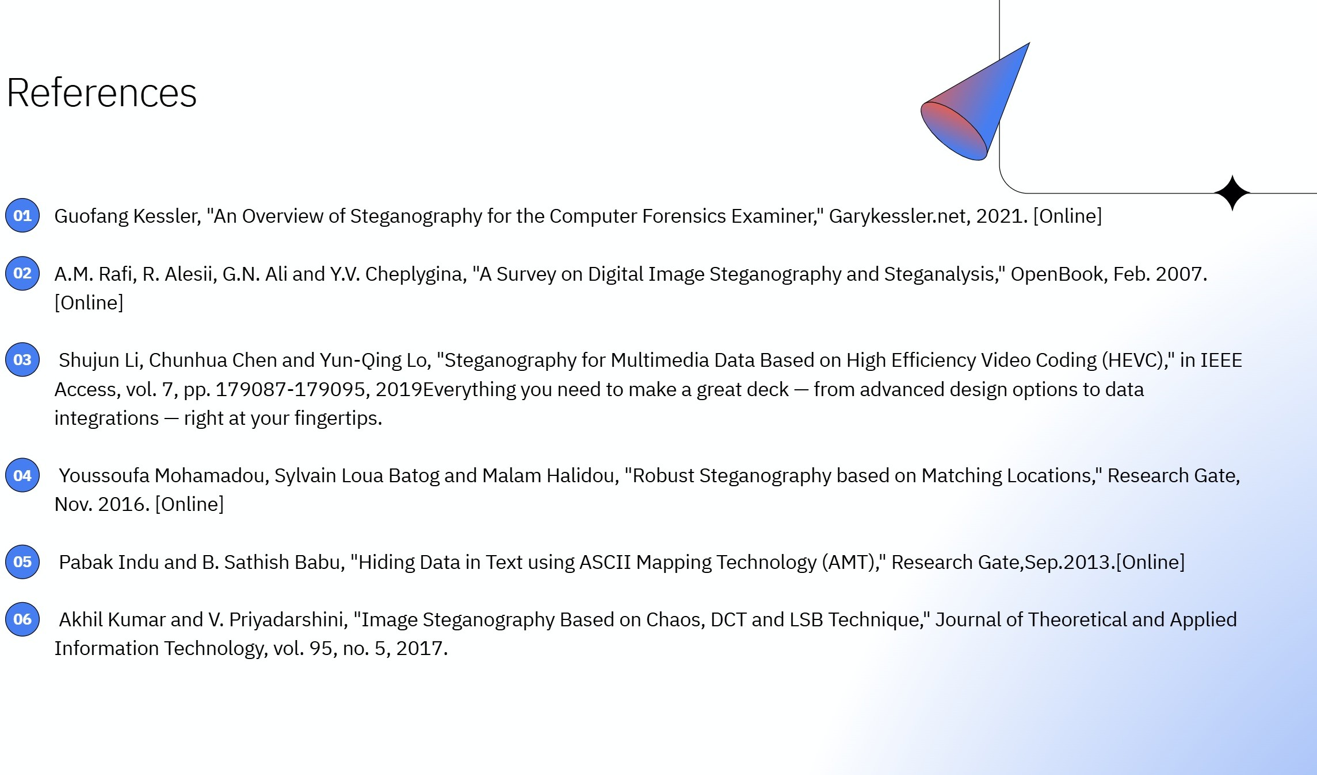

Slide 12


